Slide 1
RTTY Contesting
using Yaesu FT-710, N1MM and MMTTY
Andrzej Mazur, SP5GW

Slide 2
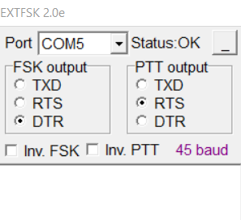
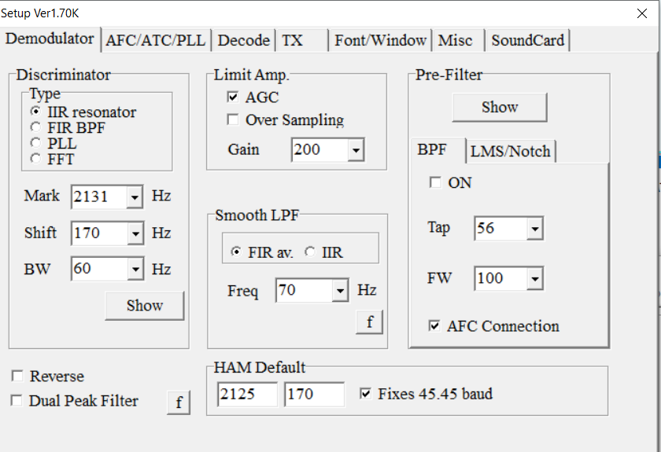
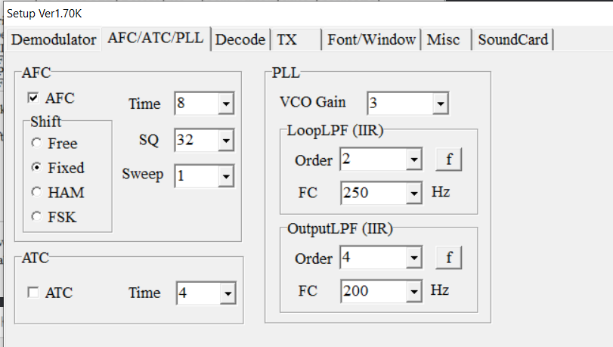
MMTTY Setup (1)
Curtuasy: Kamil, SP5MTX

Slide 3
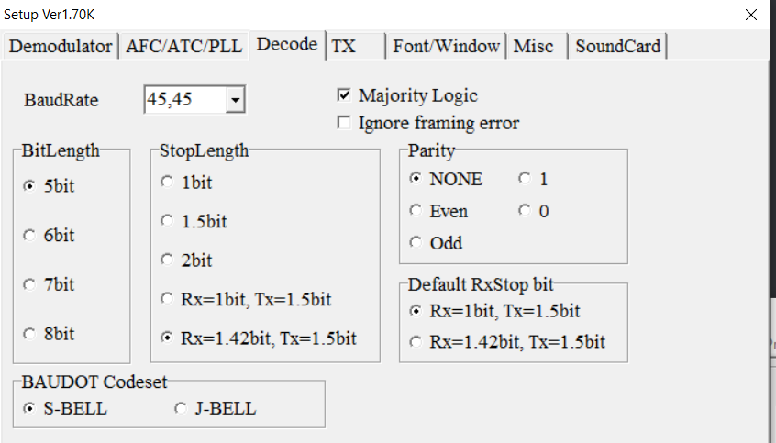
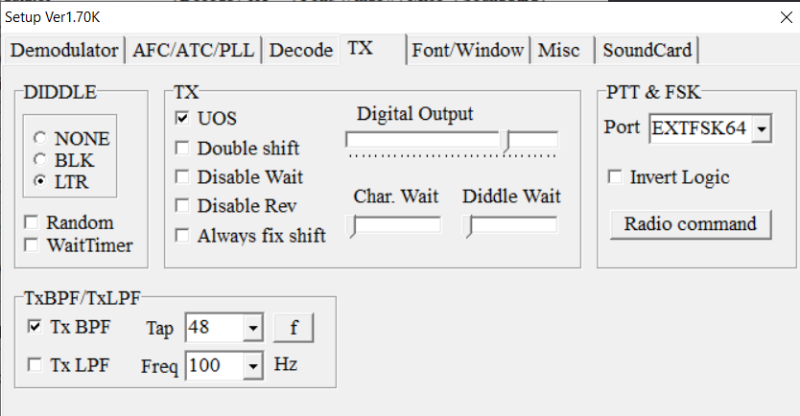
MMTTY Setup (2)
Curtuasy: Kamil, SP5MTX

Slide 4
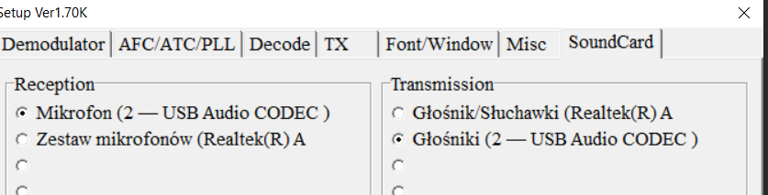
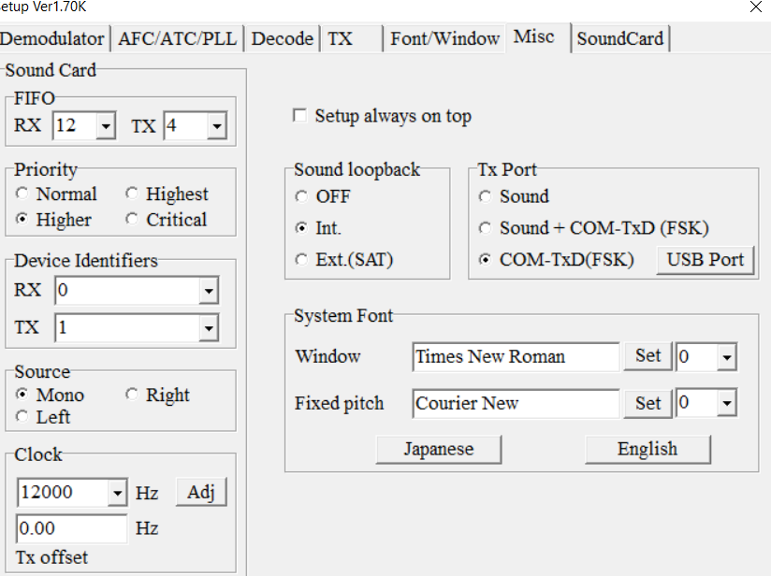
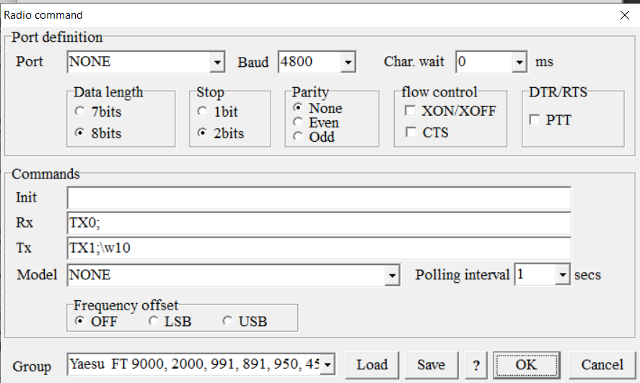
MMTTY Setup (3)
Curtuasy: Kamil, SP5MTX

Slide 5
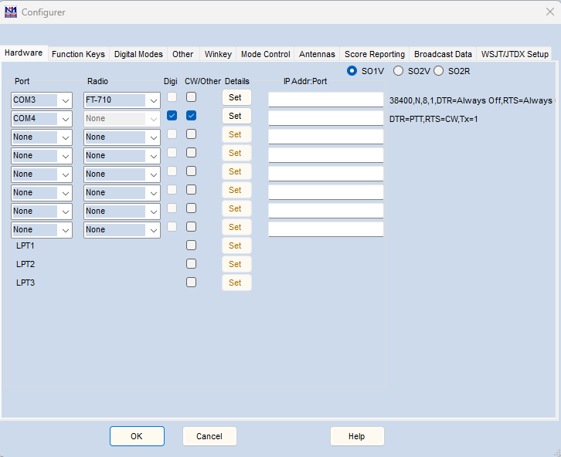
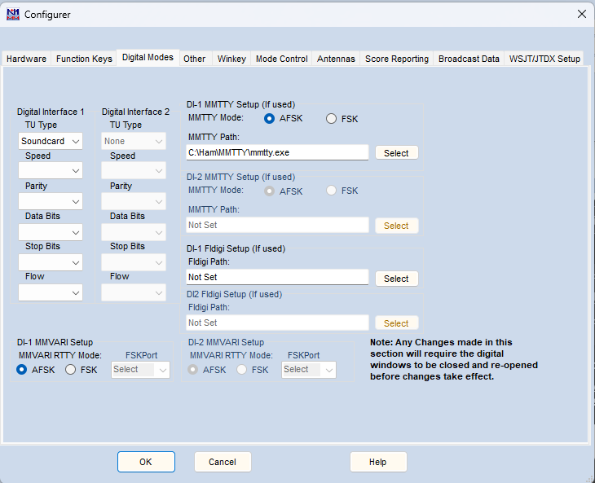
Integration FT-710 – MMTTY - N1MM Logger

Slide 6
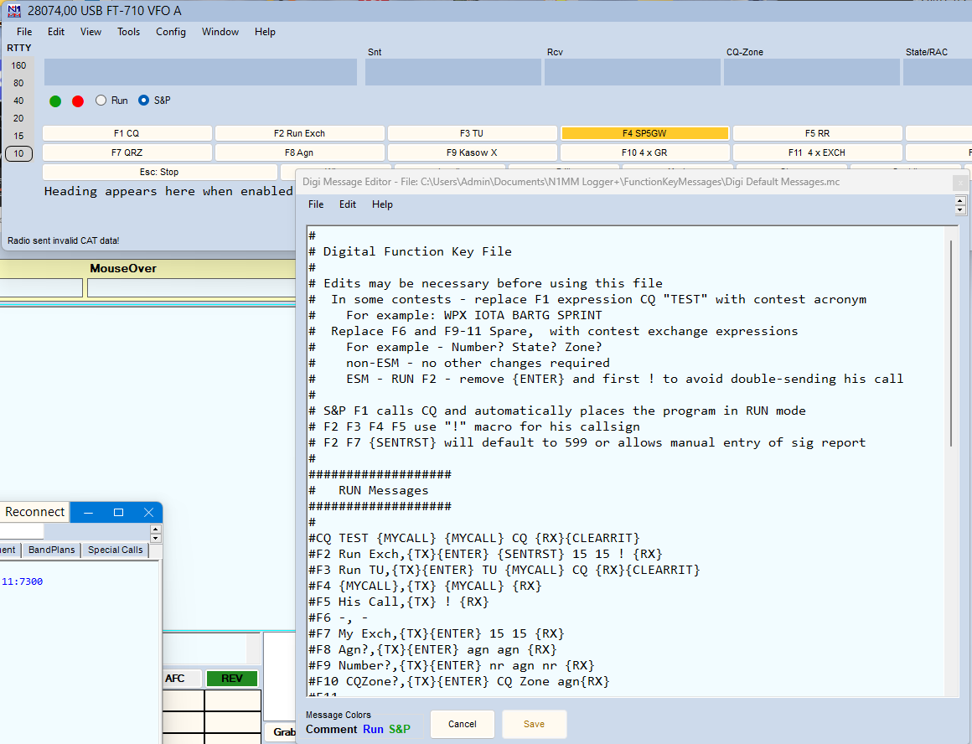
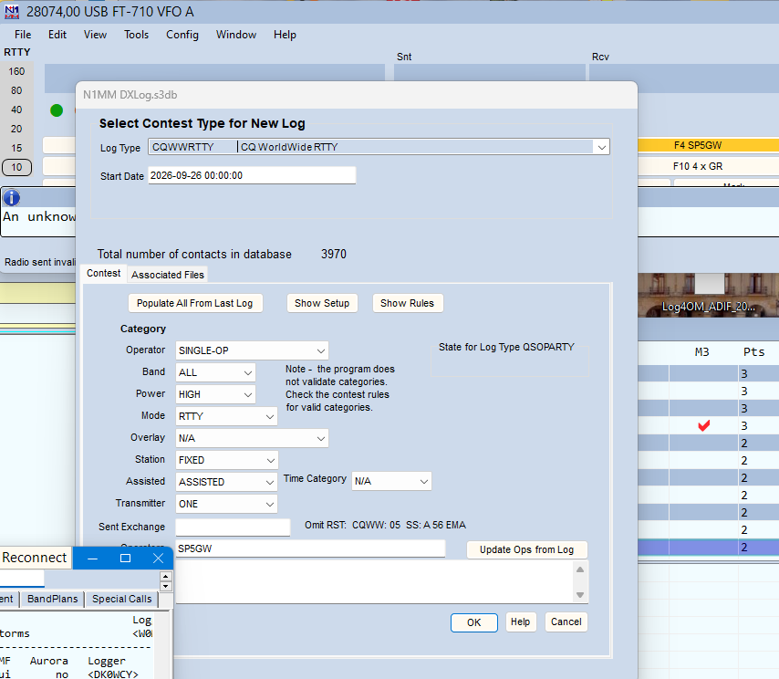
N1MM Database Configurator
Contest used as illustration: CQ WW RTTY
Right click on any of the macro
buttons to launch macro editor
(diffault macros are loaded as part of
contest config.)
File -> New Log in DB

Slide 7
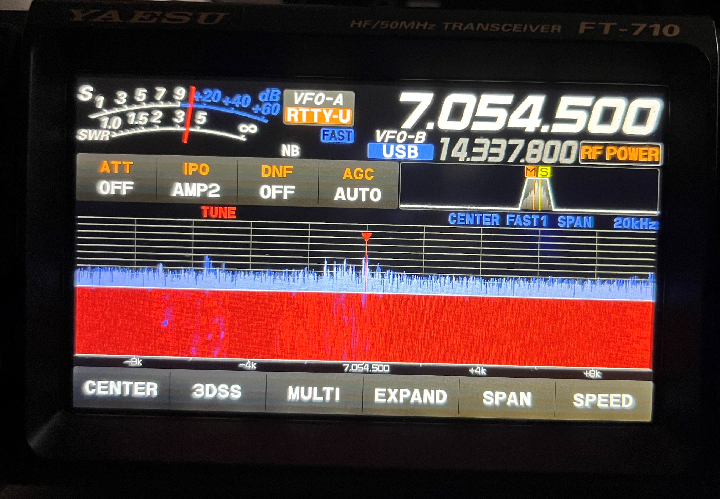
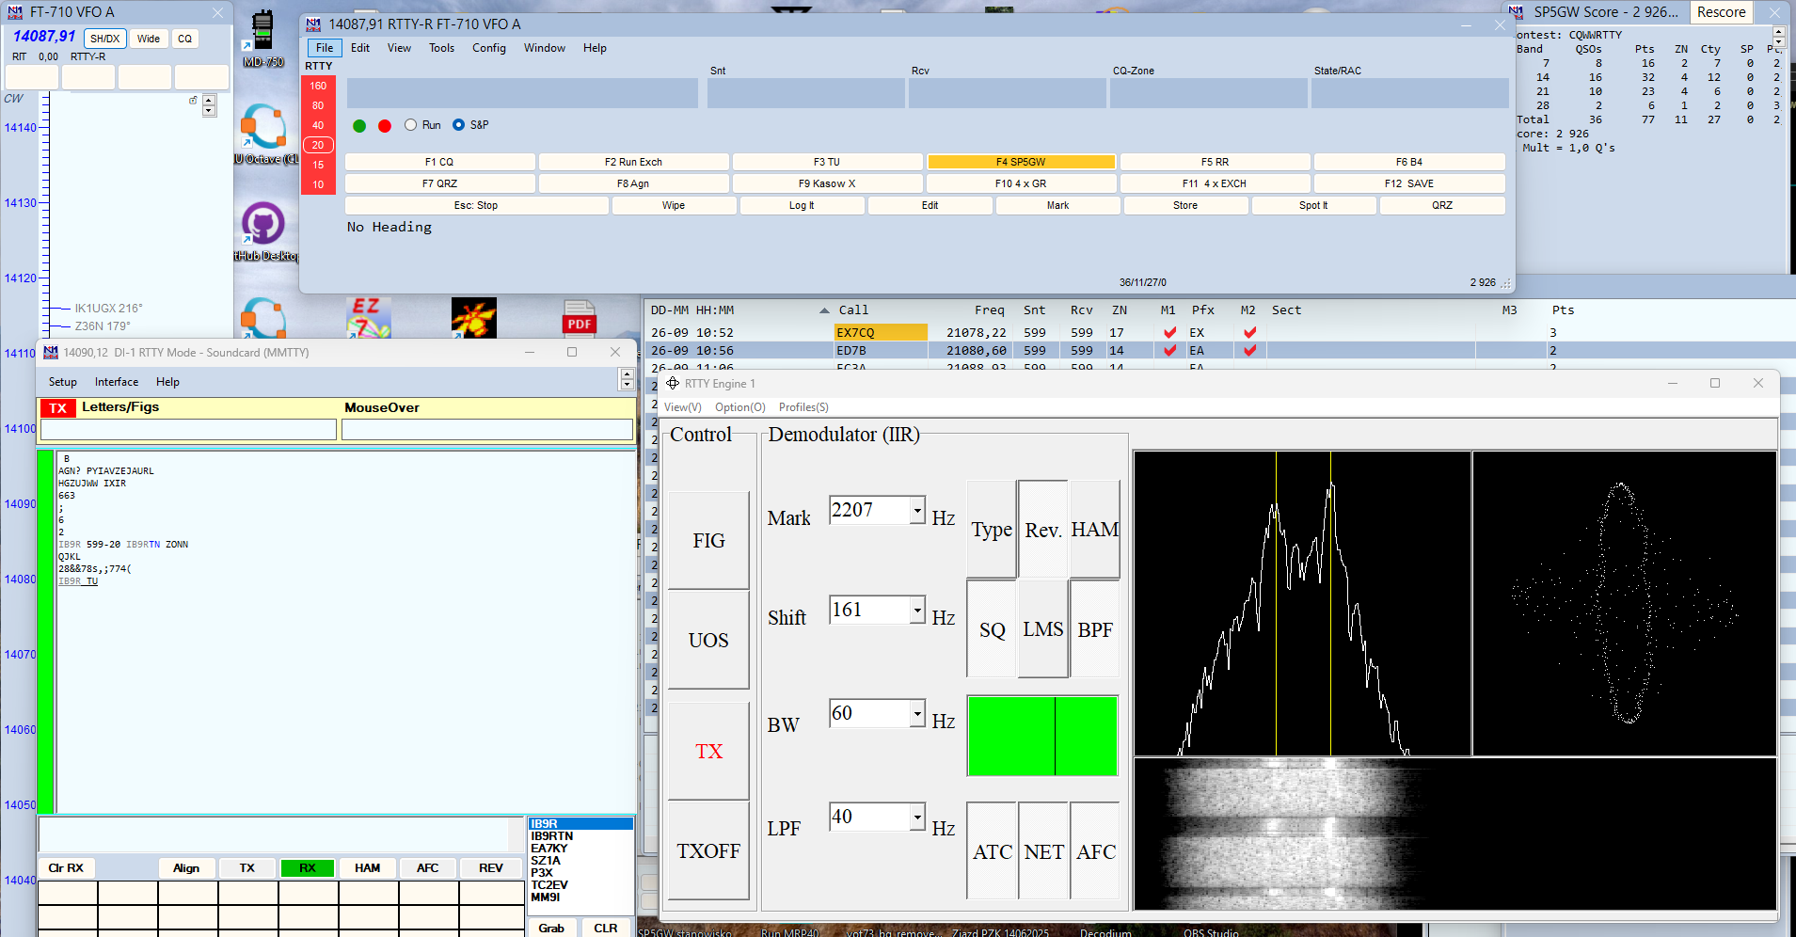
Tunning to the station
Open N1MM logger
Go to Window - > Digital Interface
(this shall open MMTTY)
Switch FT-710 to mode: RTTY-U
(rearly you will see RTTY-L being used)
It is helpful to change raio’s waterfall
span to about 20k
Tune to the station so you can see signal
spectrum as on bottom-right of the picture.
Now botm-left window shall start filling with
decoded messages
During contest use macro keys as described
on next two slides to complete qso

Slide 8
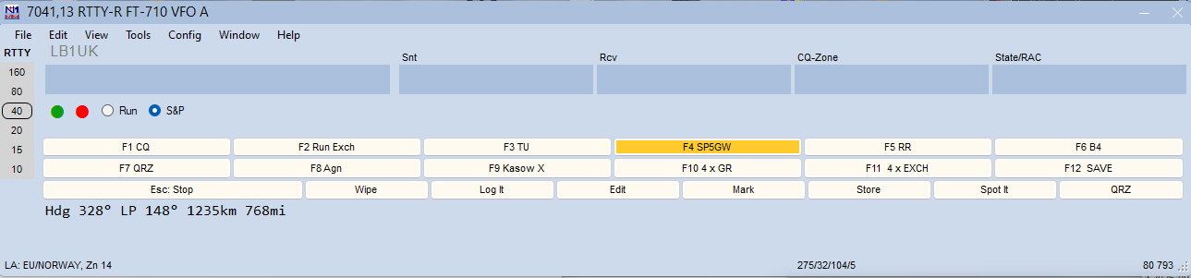
Responding to CQ
IB9R: CQ IB9R IB9R TEST (You listen for this msg)
CQ TEST IB9R IB9R TEST CQ
SP5GW: SP5GW SP5GW SP5GW (Press macro F4 SP5GW)
IB9R: SP5GW 599 15 15 IB9R or (You listen for his response)
SP5GW 599 15 15 SP5GW or
IB9R DE SP5GW 599 15 15
SP5GW: IB9R 599 15 15 SP5GW (Press macro F2 Run Exch)
IB9R: SP5GW TU IB9R TEST or (He finalizes the qso)
SP5GW TU IB9R CQ or
SP5GW TU DE IB9R QRZ? or
SP5GW TU NOW OL1Z 599 15 15
IB9R is your corespondent
SP5GW is your call sign in this example
Messages given in smaller text are variations of the main message.

Slide 9
Calling CQ
SP5GW: CQ SP5GW SP5GW TEST
IB9R: IB9R IB9R IB9R
SP5GW: IB9R 599 15 15 SP5GW
IB9R: SP5GW 599 15 15 IB9R
SP5GW: IB9R TU SP5GW TEST
SP5GW is your call sign in this example
IB9R is your corespondent

Slide 10
Thank you! sp5gw@hotmail.com

